Slide 1
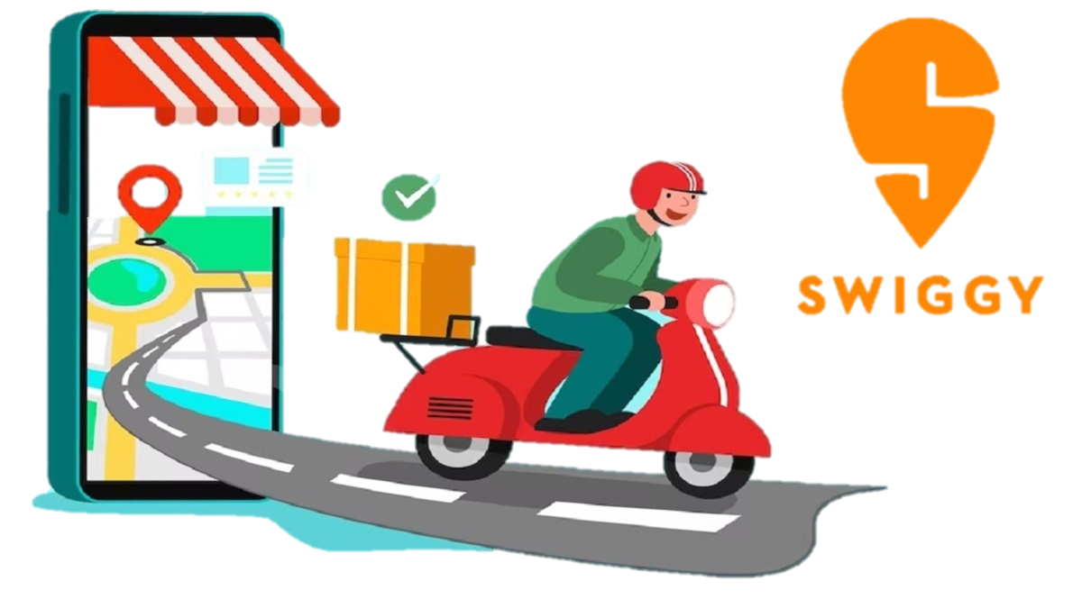

SWIGGY ANALYSIS

Slide 2
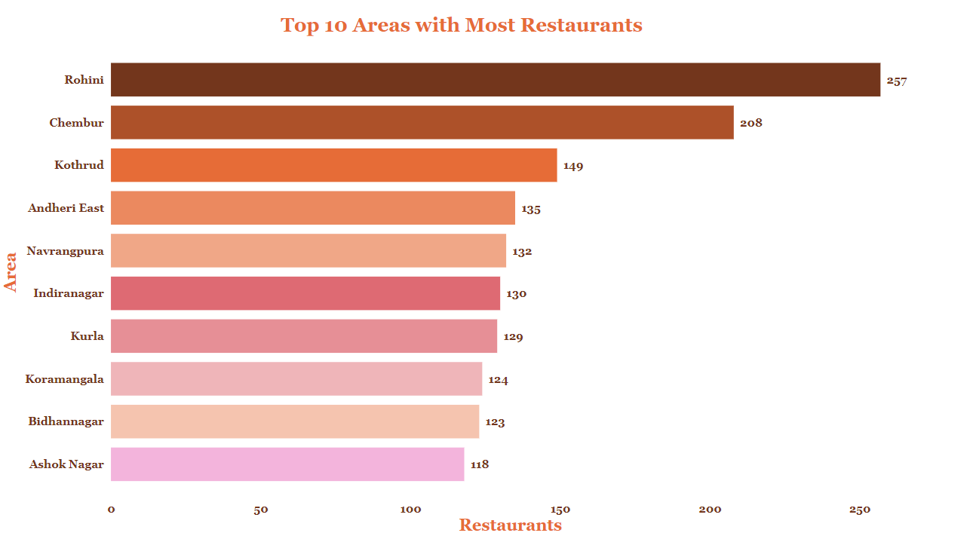
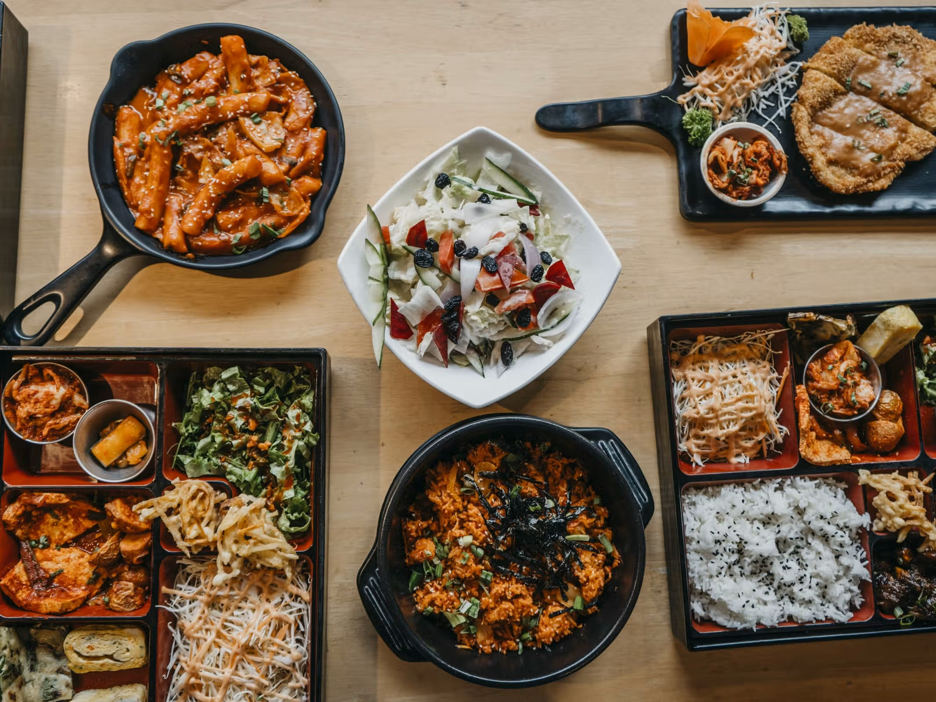
Top 10 Areas with Most Restaurants

Slide 3
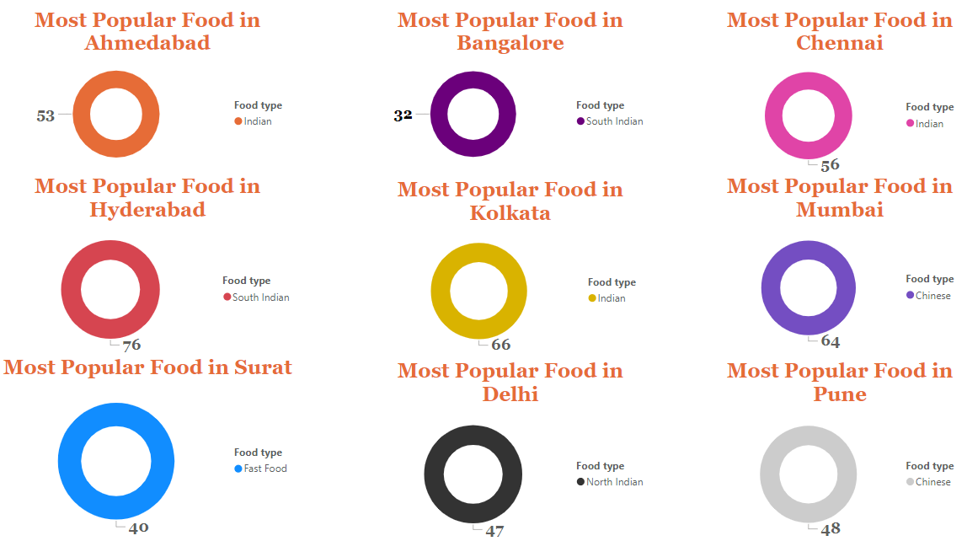
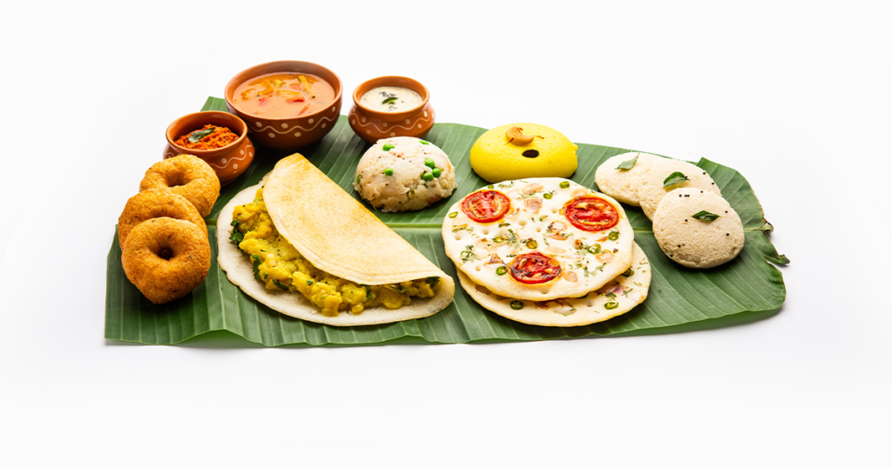
Most Popular Food Types Served by Swiggy Restaurants in Each City

Slide 4
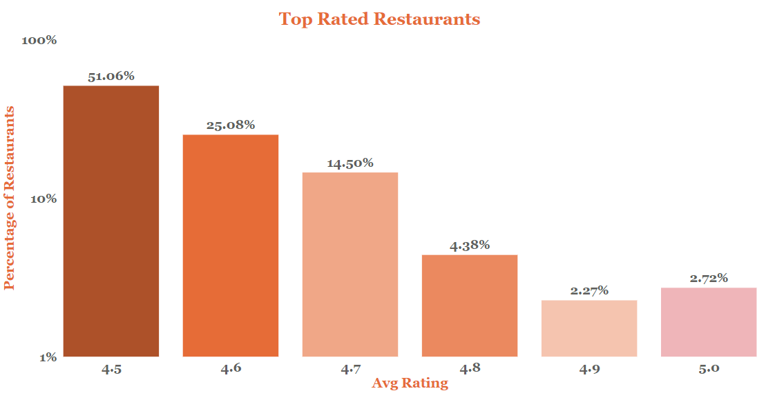
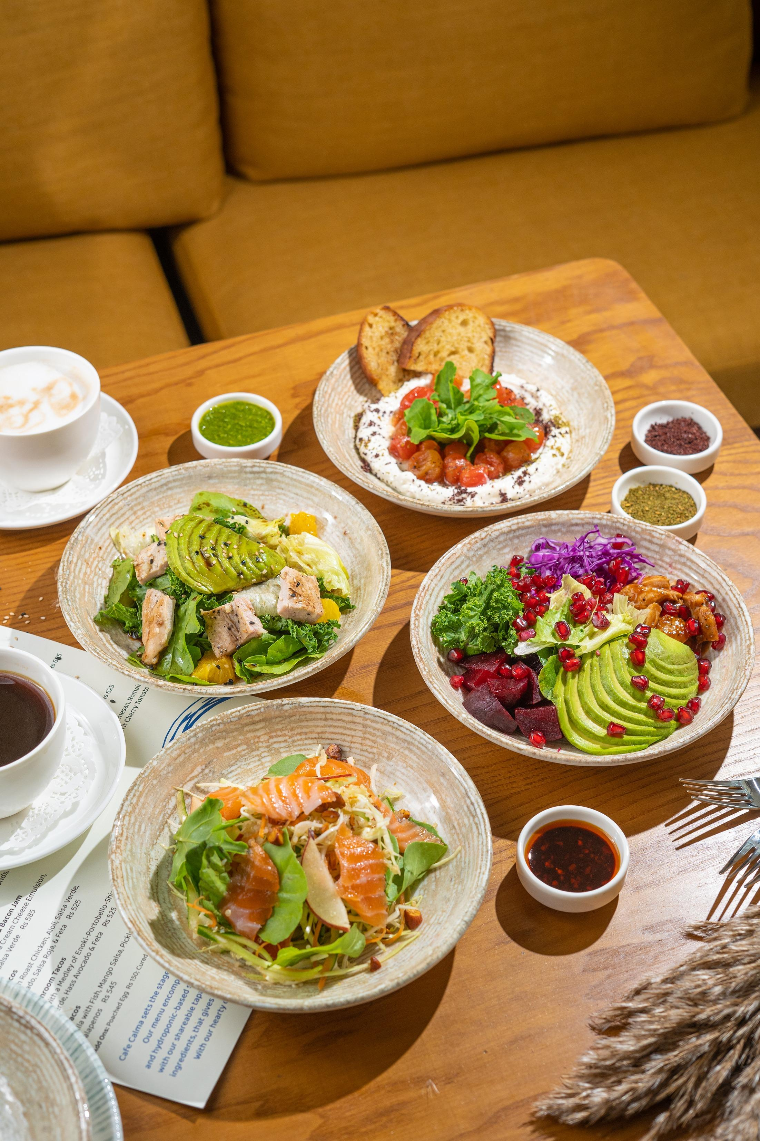
Top Rated Swiggy Restaurants (In Percentage)

Slide 5
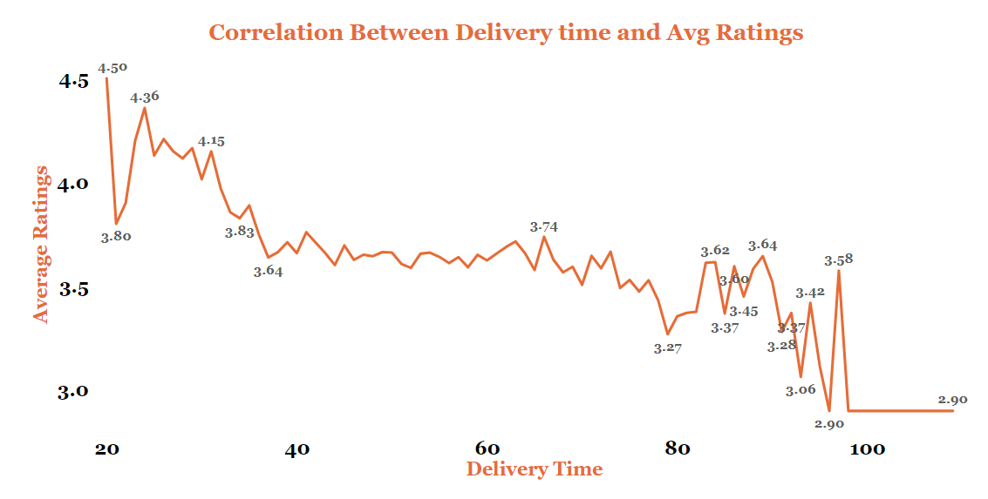
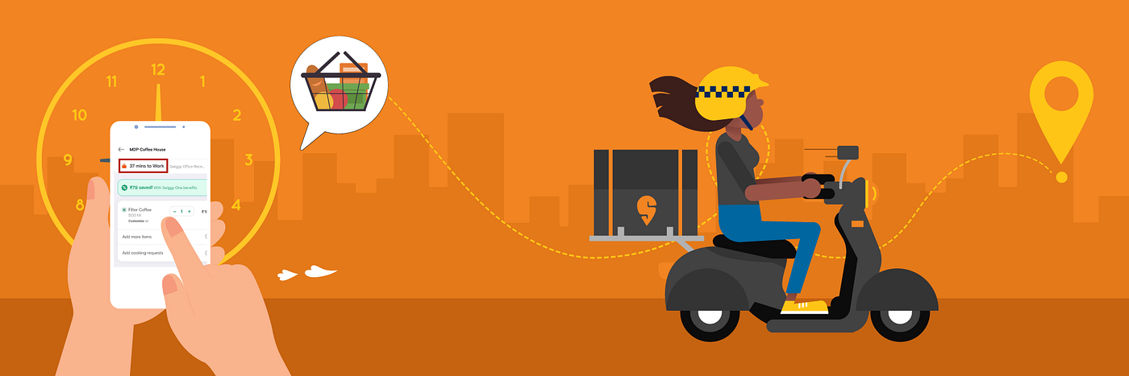
Correlation of Factors Affecting Average Rating

Slide 6
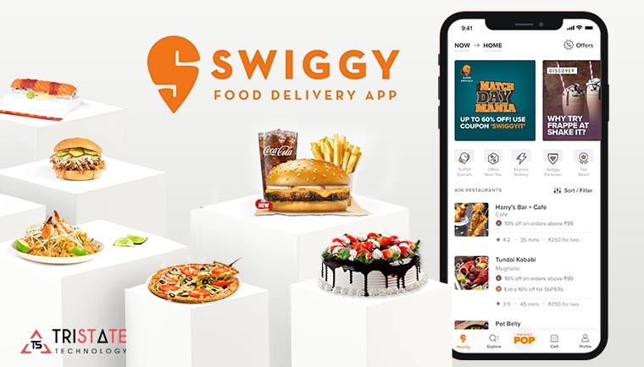
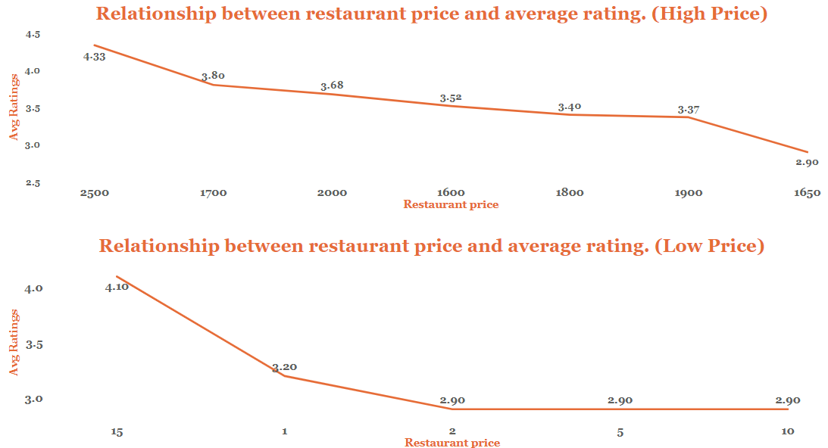
Correlation Between Restaurant Price and Average Rating

Slide 7
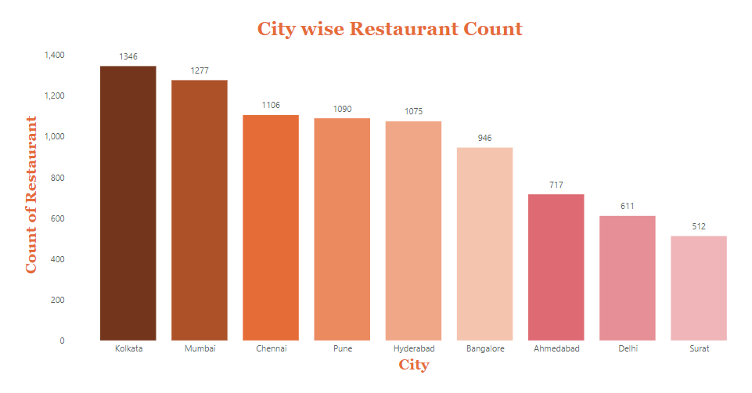
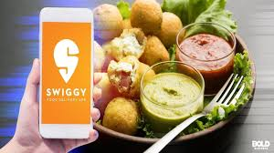
City-wise Restaurant Count

Slide 8
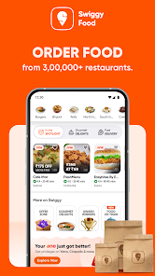
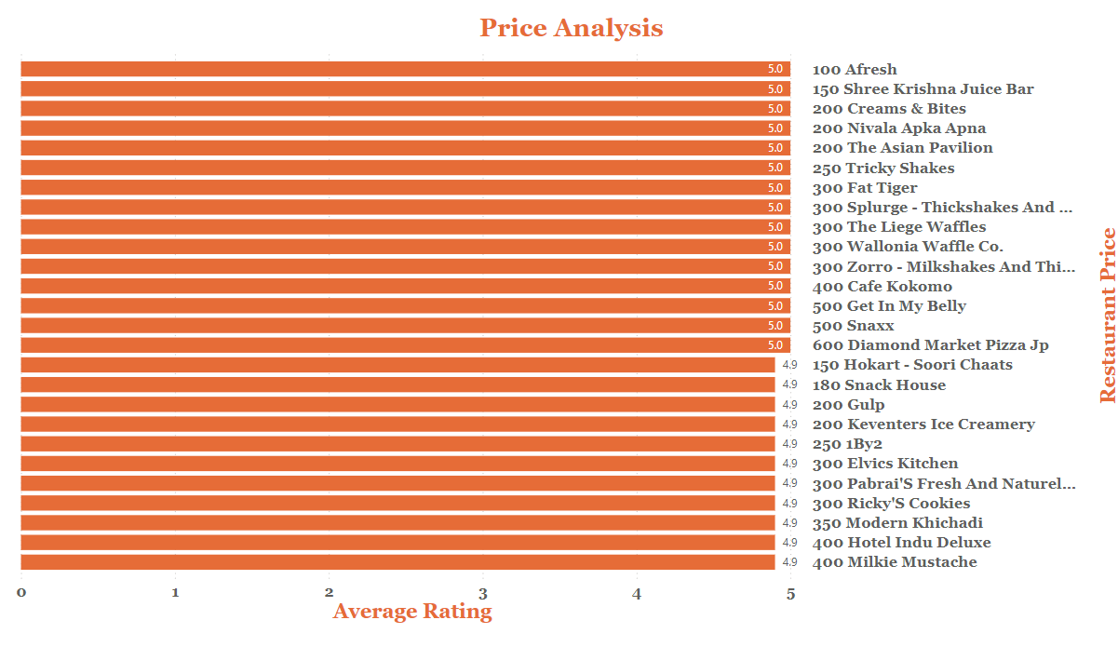
Price Analysis

Slide 9
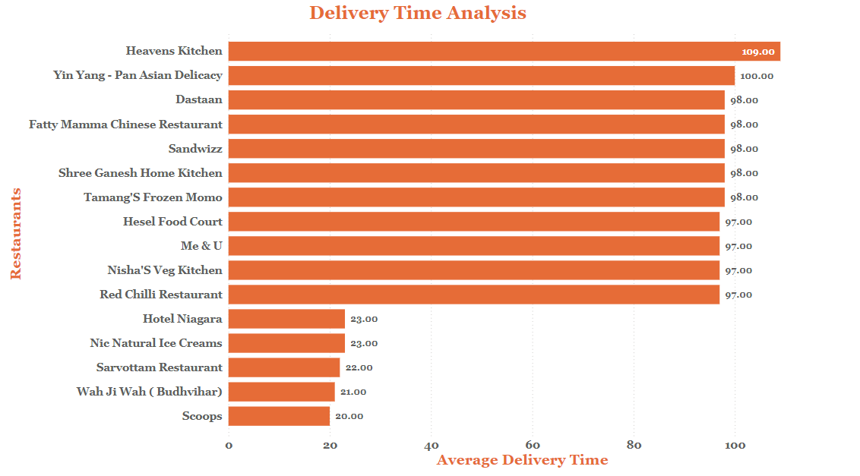
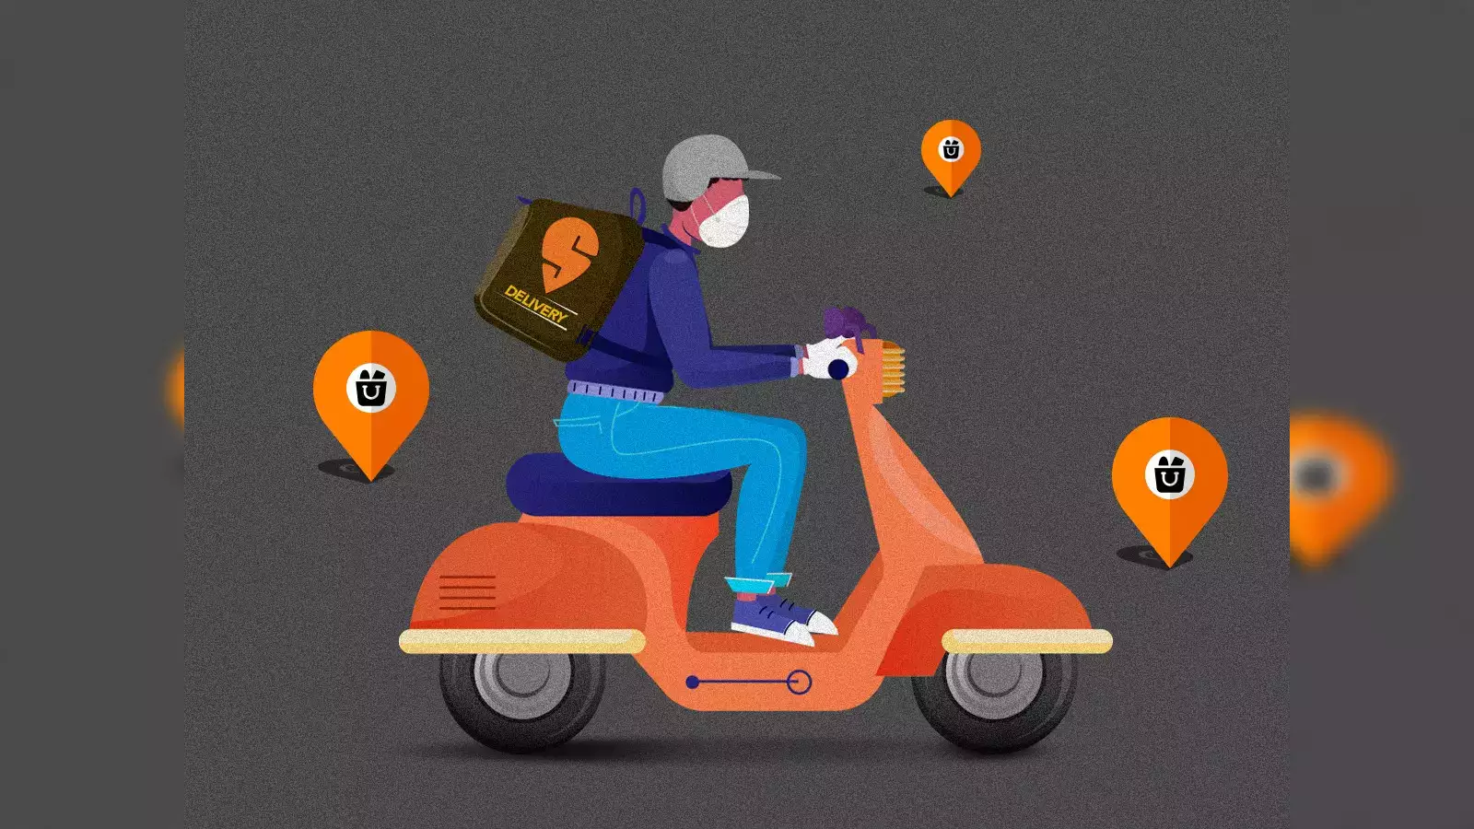
Delivery Time Analysis

Slide 10
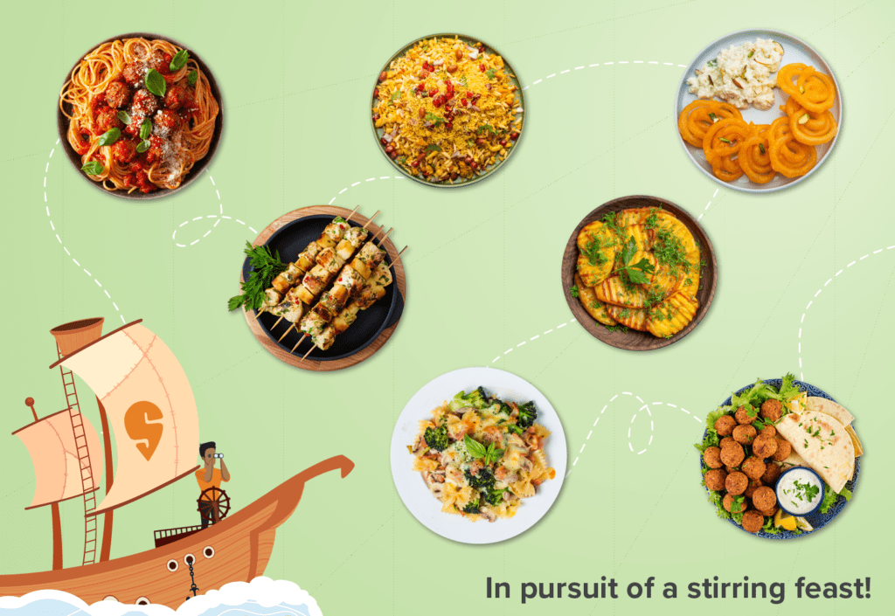
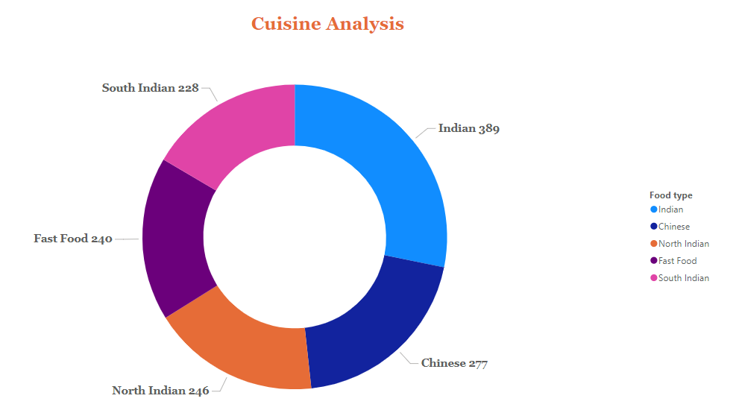
Cuisine Analysis

Slide 11
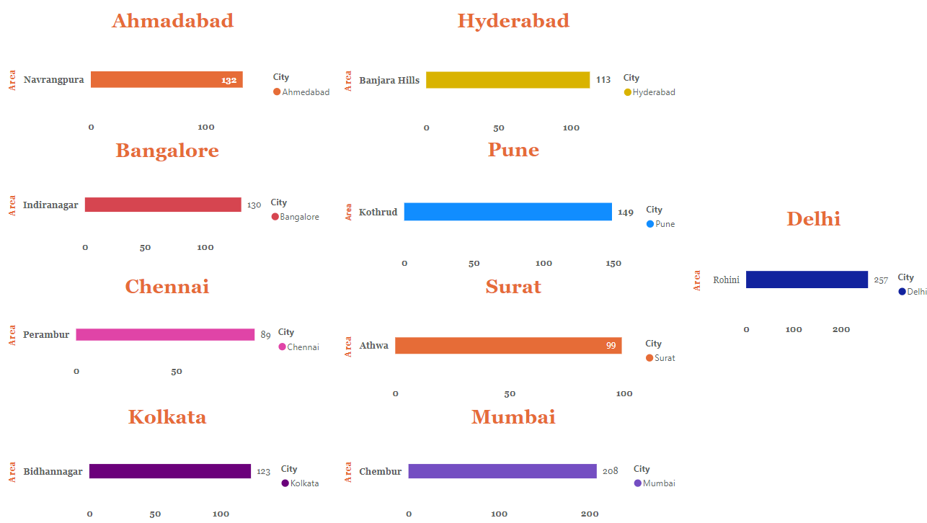
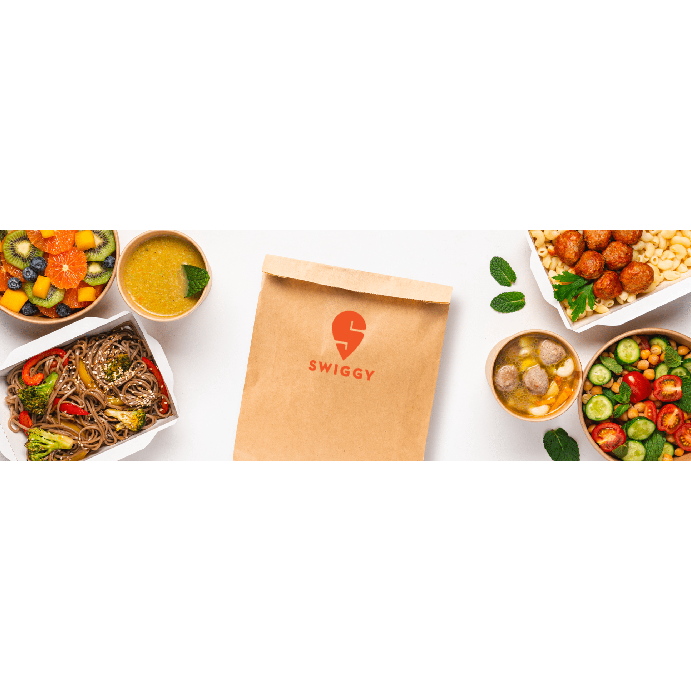
Area-wise Restaurant Analysis

Slide 12
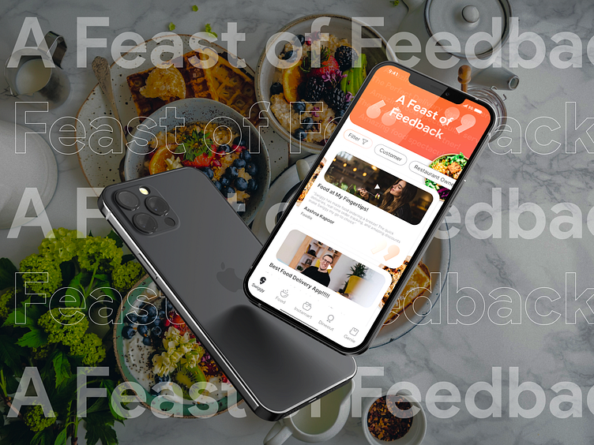
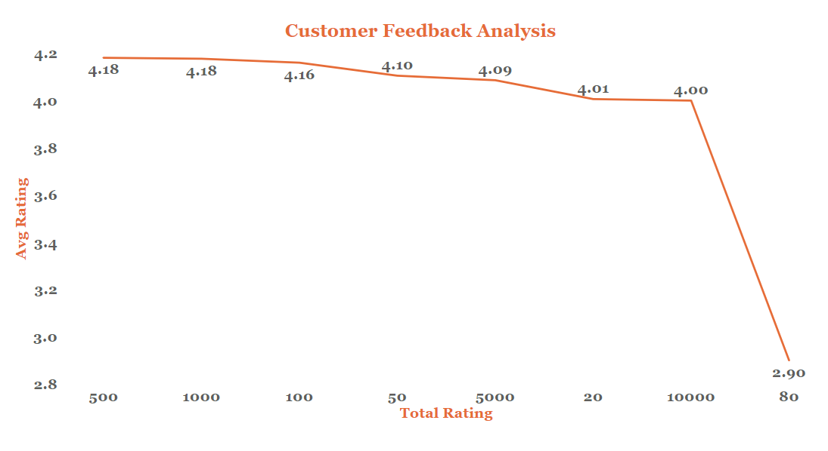
Customer Feedback Analysis

Slide 13
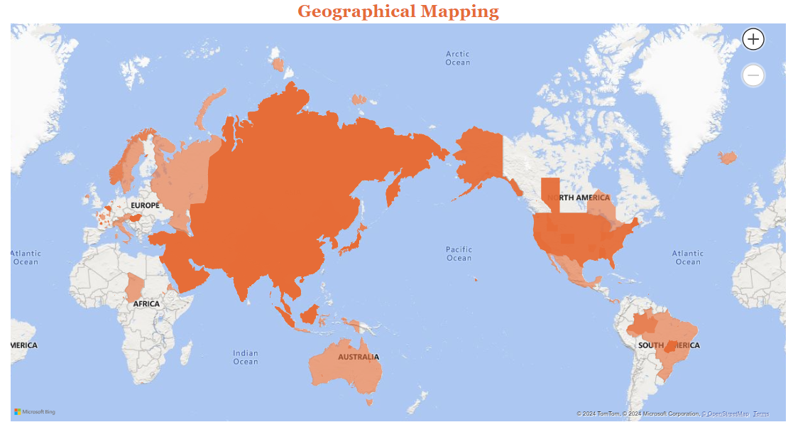
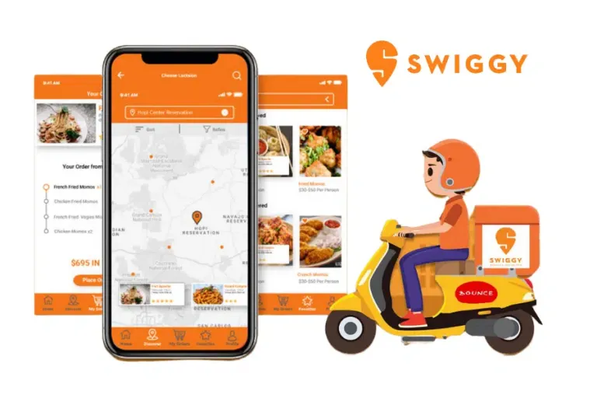
Geographical Mapping

Slide 14
Business Recommendations
Peak hours and areas with delays, Swiggy can focus on staffing and adjusting resources during those times to reduce delivery times and improve customer satisfaction.
High demand, Swiggy can consider adding more restaurants or delivery partners in those zones, ensuring faster service and a broader food selection for users.
Highlight dishes or restaurants that are frequently ordered. This can be done through app banners or discounts, leveraging what customers already like to drive repeat orders.
Frequent ordering from a subset of users, Swiggy can launch loyalty programs or rewards for frequent customers to enhance retention and increase order frequency.
For areas or times with low order volumes, Swiggy could introduce targeted promotions or discounts to boost orders during quieter periods.
Any reasons for order cancellations (e.g., unavailability, delays) and address these issues to improve reliability, which will likely improve customer trust and satisfaction.

Slide 15
